Slide 1
Objectives
In this session, you will learn to:
Use operators
Identify operator precedence
Use conditional constructs
Use loop constructs

Slide 2
Operators
Operators are used to compute and compare values
and test conditions.
They can be classified as:
  Arithmetic operators
  Assignment operators
  Unary operators
  Comparison operators
  Logical operators
  Conditional operators

Slide 3
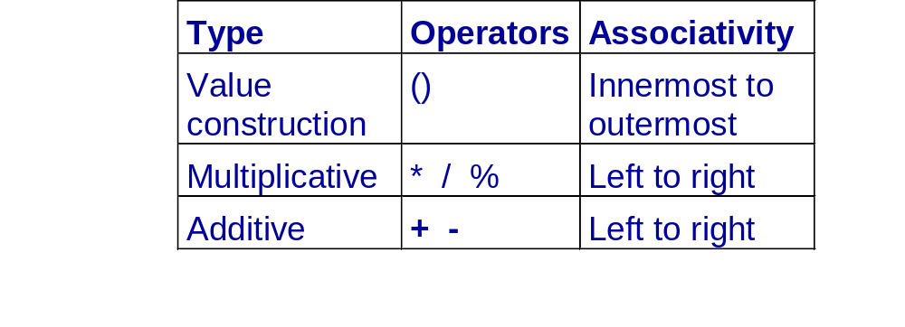
Arithmetic Operators
Are used to perform arithmetic operations.
Are used in an order according to the precedence rules.

Slide 4
Arithmetic Assignment Operators
Are used to assign the value of the right operand to
the left.
Are as follows:
=, +=, -=, /=, *=, %=

Slide 5
Unary Operators
Operate on one operand.
Are of two types:
  Increment operator (++)
  Decrement operator (--)

Slide 6
Comparison Operators
Are also called relational operators.
Are used to compare two values.
Evaluate to true or false.

Slide 7
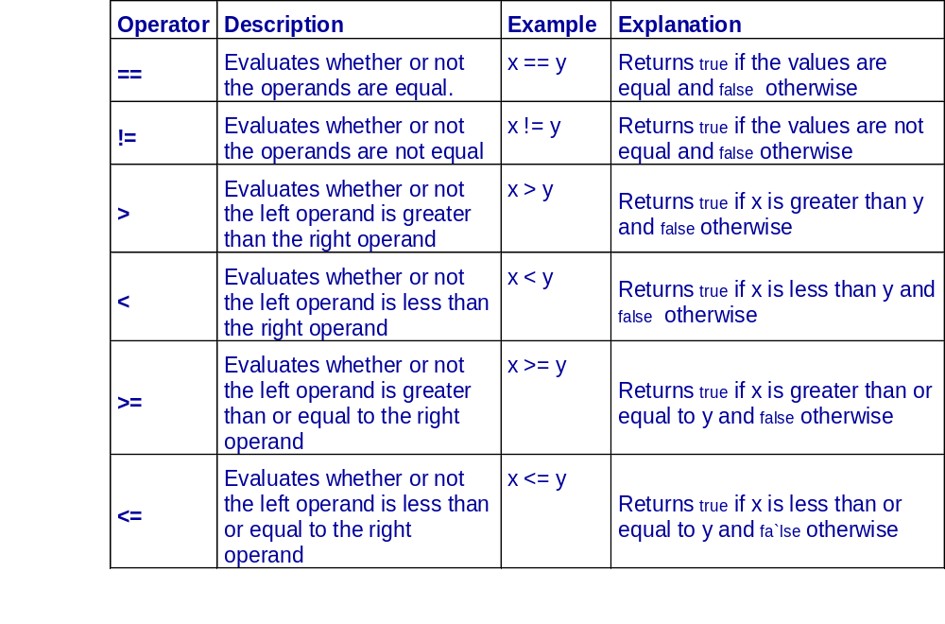
Comparison Operators (Contd.)

Slide 8
Logical Operators
Are used to combine two or more expressions.
Are of three types:
  AND (&&)
  OR (||)
  NOT (!)

Slide 9
Expressions in C++
An expression in C++ is a combination of operators
and operands and is used to compute values from
the operands.
An expression that contains only arithmetic operators
is called an arithmetic expression.
An expression that contains only logical or relational
operators is known as a logical or relational
expression.

Slide 10
Type Conversion
This process of conversion of one type into a different
type is referred to as type conversion.
C++ provides the following two methods of type
conversions:
  Implicit type conversion: It is performed implicitly by the compiler. It may result in loss of data in case a higher data type is converted into a lower data type.
  Explicit type conversion: This form of conversion forces the compiler to convert one data type into a specified data type.

Slide 11
Conditional Constructs
Control the flow of a program.
Allow selective execution of statements.
Use comparison operators for evaluating conditions.
Are of two types:
  The if…else construct
  The switch…case construct

Slide 12
The if…else Construct
In an if…else block of statements:
  Condition is evaluated first.
  If the condition is true, statements in the
  immediate block are executed.
  If the condition is false, statements in the else
  block are executed.

Slide 13
The if…else Construct (Contd.)
Syntax:
if (expression)
{
statements;
}
else
{
statements;
}

Slide 14
The switch…case Construct
Is used when there are multiple values for a variable.
Evaluates condition-variable of the switch
statement and compares with each case constant.
Requires a break statement to exit from its body.
Uses the default keyword for associating any other
statements other than mentioned in the case
constant.

Slide 15
Loop Constructs
Cause a section of a program to be repeated a
certain number of times.
Are of three types:
  while loop
  do…while loop
  for loop

Slide 16
The while Loop
Continues until the evaluating condition becomes
false.
Syntax:
while (expression)
{
statements;
}
Requires the continue statement to return the
control to the beginning of while loop skipping any
other statements after the continue keyword.

Slide 17
The while Loop (Contd.)
  The break statement is used to exit a loop before
  the loop condition is re-evaluated after iteration.
  The continue statement is used to skip all the
  subsequent instructions and take the control back to
  the loop.

Slide 18
The do...while Loop
Continues until the evaluating condition becomes
false.
Executes the body of the loop at least once.
Syntax:
do
{
statements;
} while(boolean_expr);

Slide 19
The for Loop Construct
Provides a compact way of specifying statements that
control the repetition of the steps within the loop.
Contains three expressions:
  The initialization expression
  The test expression
  The increment/decrement expression

Slide 20
The for Loop Construct (Contd.)
Syntax:
for( initialization_expr; test_expr; change_expr)
{
    statements;
}

Slide 21
Nested Loops
Similar to the nested if…else or nested
switch…case constructs, you can nest loops within
another loop. In a nested loop, the inner loop
terminates before the termination of the outer loop.

Slide 22
Summary
In this session, you learned that:
Operators are used to compute and compare values and test multiple conditions.
You use arithmetic operators to perform arithmetic operations, such as addition, subtraction, multiplication, and division.
You can also use arithmetic assignment operators to perform arithmetic operations.
The unary operators, such as the increment and decrement operators operate on one operand.
Comparison operators, which are also called
relational operators, are used to compare two values.

Slide 23
Summary (Contd.)
Logical operators are used to combine two or more expressions.
Conditional constructs are used to allow the selective execution of statements. The conditional constructs in C++ are:
  if...else
  switch...case
Looping constructs are used when you want a section of a program to be repeated a certain number of times. C++ offers the following looping constructs:
  while
  do...while

Slide 24
Summary (Contd.)
  for
The break and continue statements are used to control the program flow within a loop.

